Slide 1
System calls
The interface between the user and the OS
Procedure library is provided to make it possible to make system calls from C programs
What if a program in user mode needs a system service?
E.g read(fd,buffer,nbytes)
  It has to execute a trap or system call instruction to transfer control to the OS
  The OS then figures out what the calling process wants by inspecting the parameters
  Then it carries out the system call and returns control to the instruction following the system call

Slide 2

Steps in Making a System Call
There are 11 steps in making the system call
read (fd, buffer, nbytes)
1

Slide 3
Steps
Steps 1-3 push the parameters onto the stack
  First and third parameters are called by value.
  Second parameter is called by reference.
Step 4: is the actual call to the library procedure.
  This instruction is the normal procedure call instruction used to call all procedures.
Step 5: The library procedure typically puts the system call number in a place where the OS expects it such as a register.

Slide 4
Steps
Step 6: Executes a TRAP instruction to switch from user mode to kernel mode and starts execution at a fixed address within the kernel.
Step 7: Kernel code examines the system call number
  Then dispatches to the correct system call handler via a table of pointers to system call handler indexed on system call number.
Step 8: At this point, the system call handler runs.

Slide 5
Steps
Step 9: Once system call handler completes its work, control may be returned to the user-space library procedure at the instruction following the TRAP instruction.
Step 10: This procedure then returns to the user program in the usual way procedure call returns.
Step 11: To finish the job, the user program has to clean up the stack.

Slide 6
System calls for Process Management
Fork system calls and its return values
Waitpid system call
Execve system call
E.g cp file1 file2
Processes have their memory divided into three segments (text,data,stack)
  Text segment : program code
  Data Segement: variables
  Stack Segment

Slide 7
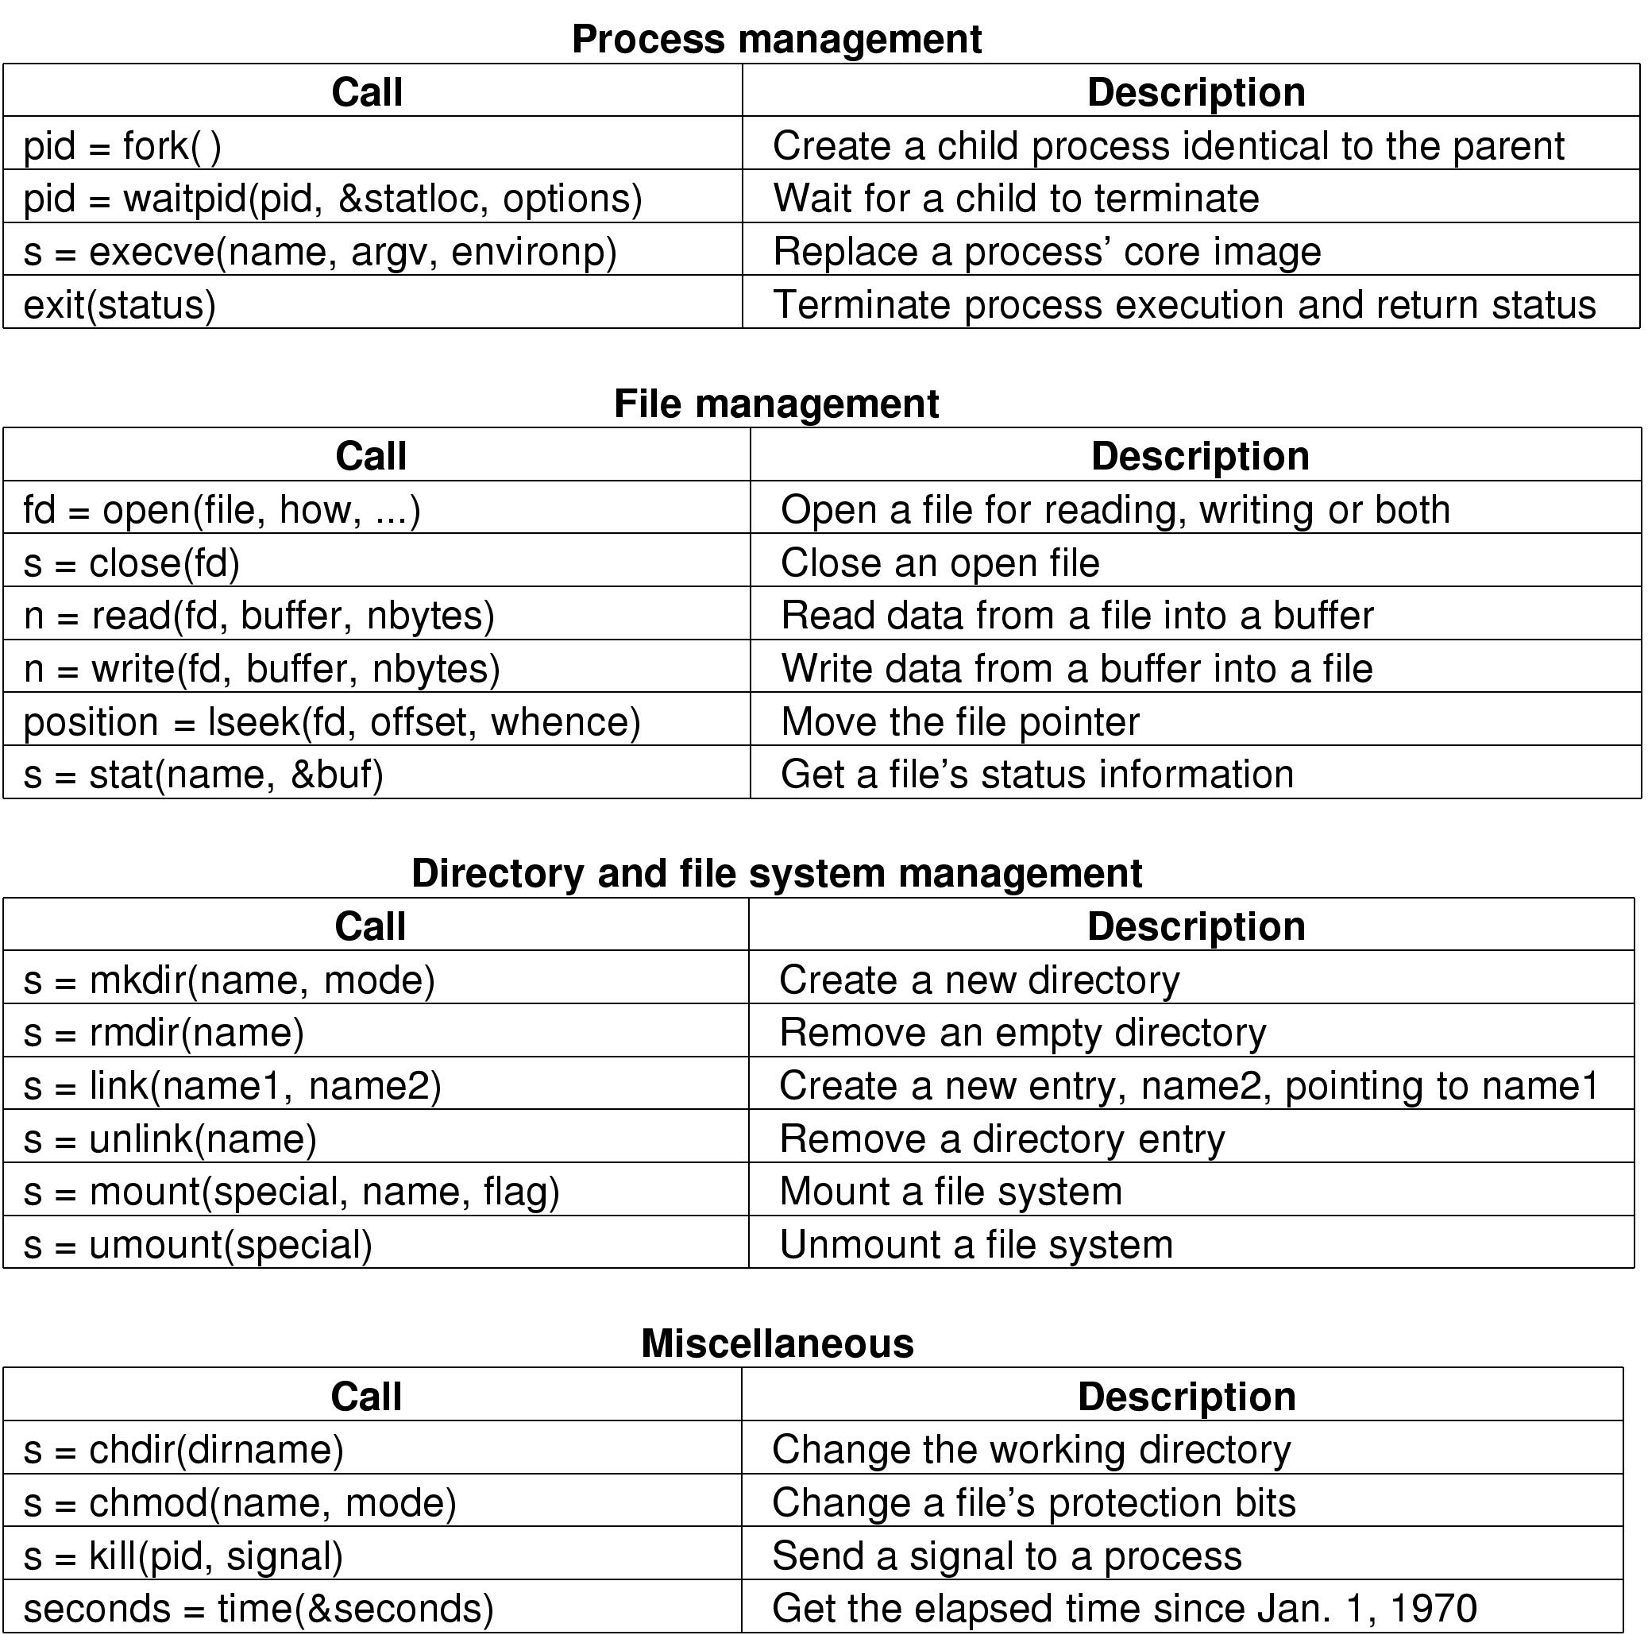
Some System Calls For Process Management

Slide 8
System calls for File Management
open (O_RDONLY, O_WRONLY…)
Lseek: changes the value of the position pointer for subsequent calls to read or write.
Mode of the file: use stat system call
  To know about type of file, size, time of last modification
  First parameter: file to be inspected.
  Second parameter: a pointer to a structure where information is to be put.

Slide 9
Some System Calls For File Management

Slide 10
System calls for Directory Management
mkdir, rmdir
Link: allow the same file to appear under two or more names often in different directories.
mount system call
unmount

Slide 11
Some System Calls For Directory Management

